Slide 1
Lecture 1 - Review of Functions, Derivatives, and Integrals
DS 4400: Machine Learning and Data Mining 1

Slide 2




The place where I was born and grew up (Canary Islands, Spain)

Slide 3




Tenerife

Slide 4





My wife is from China
We have two daughters (18 and 21), a cat (Fifi), and a dog (Lilo)
I worked for 21 years as a computational physicists at the Oak Ridge National Laboratory, ORNL
I love the outdoors
I practice rock climbing, trail running, whitewater kayaking, mountain biking, and this summer I learned to windsurf and surf

Slide 5
Today
Introduction
First Topics
Basic Derivative Rules
Derivatives in Python
Very Basic Integrals

Slide 6
Course Overview
Canvas will serve as our main website, includes links to everything like Gradescope, Khoury Office Hours, Homework Assignments, and these Lecture Notes
Syllabus highlights:
You can always email me or the Teaching Assistants
Bring laptop, pen and paper to every class
No late homework accepted
Midterm dates will be updated shortly.
Last Exam

Slide 7
Quick Review of Differentiation and Integration
Topics for Today:
Why derivatives are important for Machine Learning (ML)
The intuitive understanding of derivative
Constant Rule, Power Rule, Sum Rule, Product Rule
Derivatives of exponential and log functions
The difference between different log functions
The Chain Rule
How to find derivatives using python
The inverse of derivatives give you area under the function (integrals!)
How to use python to find the integral of a function

Slide 8
Why are derivatives important in ML
1. Optimization with Gradient Descent:
Derivatives help minimize the loss function by finding the steepest descent direction.
2. Backpropagation in Neural Networks:
Derivatives compute gradients to adjust weights for better predictions.
3. Measuring Sensitivity:
Derivatives reveal how outputs change with inputs or parameters.
4. Regularization:
Prevents overfitting by adding penalties based on derivatives.
5. Activation Functions:
Gradients of activation functions guide error correction during training.
6. Feature Importance:
Derivatives help identify key features influencing predictions.

Slide 9
Functions and Their Derivatives
Functions
Derivatives
Given a function f (x), we often
The function tells us:
given some input value x
what is the output value f (x)
For example, given the function f (x) = 0.3x² + 0.2, shown as the green line on the next slide:
If we plug in 0, we would get 0.2
If we plug in 1, we would get 0.5
want to know
As the value of input x increases, will the function go up or down?
The derivatives of a function gives this information...
If the derivative is positive, as
x ↑⇒ f (x) ↑
If the derivative is negative, as
x ↑⇒ f (x) ↓
The magnitude of the derivative tells you how quickly the function is going up or down

Slide 10
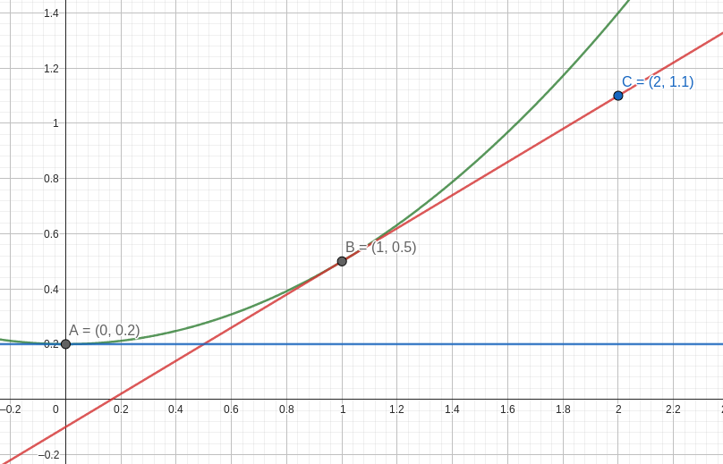
Functions and Their Derivatives

Slide 11


Functions and Their Derivatives
We can calculate the derivative at any point by finding the derivative function; symbolically:
d
taking the derivative
′
_{dx} f (x) −−−−−−−−−−→ f (x)
For example, for the function f (x) = 0.3x² + 0.2
(as the green line), then we would write
^{d} (0.3x² + 0.2) ⇒ f′(x) = 0.6 x
dx
If we plug in the value of x = 1 into f′(x), it gives us the derivative at the point x = 1 which is
f′(1) = 0.6(1) = 0.6
This implies that at x = 1 the function is increasing; it also represents the slope of the tangent line at x = 1

Slide 12
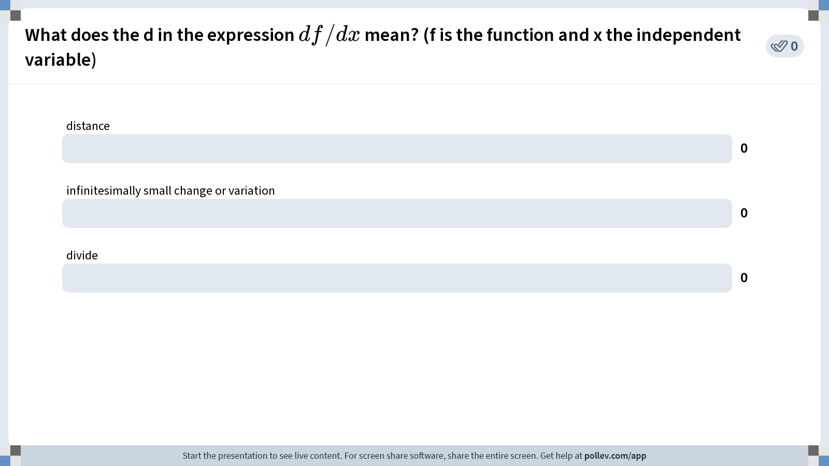
Notes:
Do not modify the notes in this section to avoid tampering with the Poll Everywhere activity. More info at polleverywhere.com/support What does the d in the expression $$df/dx$$ mean? (f is the function and x the independent variable)
https://www.polleverywhere.com/multiple_choice_polls/gnoCknDV24zZKOhMHxrrz

Slide 13
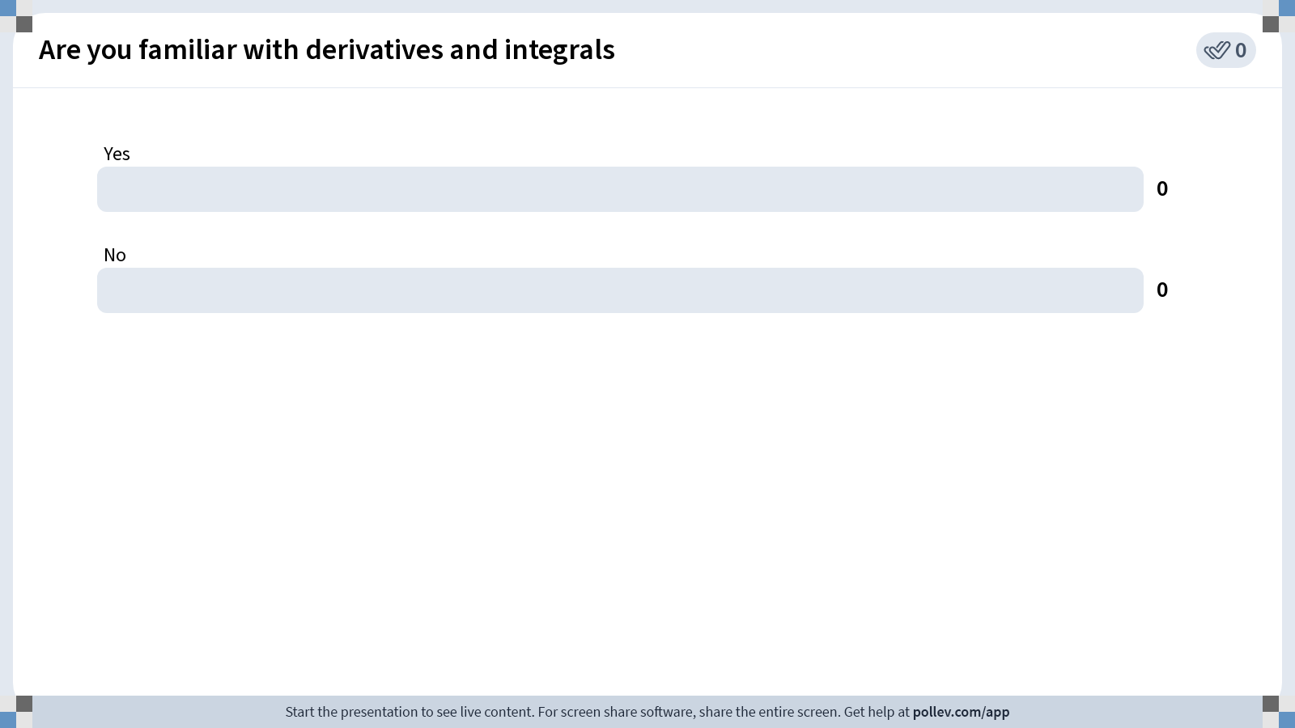
Notes:
Do not modify the notes in this section to avoid tampering with the Poll Everywhere activity. More info at polleverywhere.com/support Are you familiar with derivatives and integrals
https://www.polleverywhere.com/multiple_choice_polls/U9j2kUnINJbnkN9surfAY

Slide 14
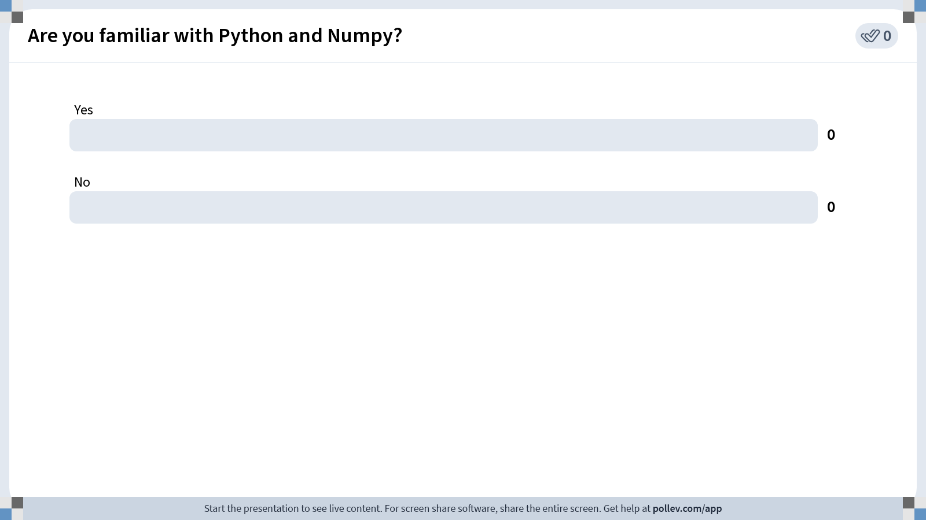
Notes:
Do not modify the notes in this section to avoid tampering with the Poll Everywhere activity. More info at polleverywhere.com/support Are you familiar with Python and Numpy?
https://www.polleverywhere.com/multiple_choice_polls/VUyGu4oBXEHYpXwCOLUKl

Slide 15
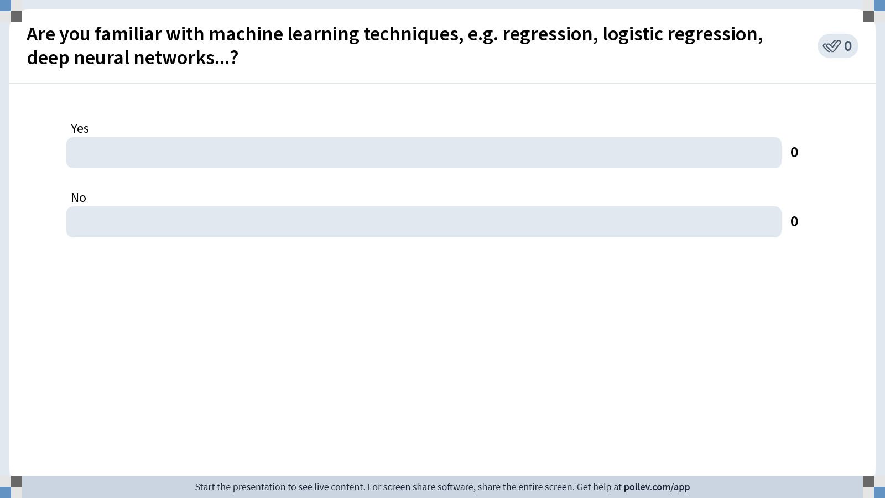
Notes:
Do not modify the notes in this section to avoid tampering with the Poll Everywhere activity. More info at polleverywhere.com/support Are you familiar with machine learning techniques, e.g. regression, logistic regression, deep neural networks...?
https://www.polleverywhere.com/multiple_choice_polls/yhaXgQc4liTNwuO8Hh3F8

Slide 16
Functions and Their Derivatives
Note that if we find the derivative at x = 2:
f′(2) = 0.6(2) = 1.2
The function is still increasing, but at a faster rate, which makes sense for convex quadratic functions as x increases

Slide 17
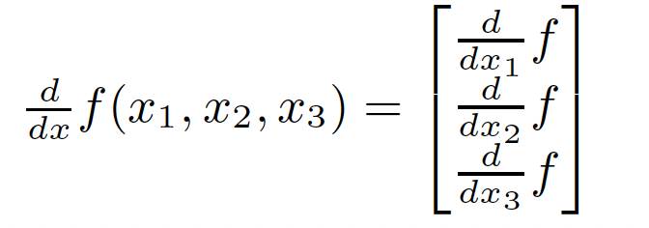
Functions can have multiple inputs
A function can have multiple inputs
Here is an example:
f (x1, x2, x3) = x1 + 2x2 − 3x3
where, f (1, 0, 1) = 1 + 0 − 3 = −2
When the function has multiple inputs:
we need to know how increasing each input would impact the function
therefore, we represent the derivative as a vector where
we take the derivative with respect to one unknown/variable at a time

Slide 18
Moving Forward
Taking a ML course without knowing basic math would be like taking a Shakespeare literature class without knowing how to speak English.
This course is designed to catch up students with a wide variety of backgrounds and knowledge in a short amount of time; if you are lost at any point, please make use of office hours, and don’t be afraid to ask questions!
Throughout the course we will be learning, iteratively:
Relevant mathematical concepts (calculus, linear algebra, statistics, probability)
How they relate to machine learning algorithms meant to model real data
How to implement those algorithms via programming in python

Slide 19
Basic derivative rules: The Constant Rule
If we have a function of only a constant such as f (x) = .2
Notice that the function isn’t going up or down
In other words, as we increase x, f (x) is going up by 0.
Therefore, the derivative of a constant value is always 0 Other examples,
^{d} 3 = 0 • ^{d} c = 0
dx dx
^{d} x = 1 ^{• d} x2 + x3 = 0 (assuming x₂ and x₃ are independent of x₁)
dx dx1

Slide 20
The Power Rule
If we have a function with a variable such as f (x) = x³, the rule for the derivative is:
multiply x by the power value
subtract the power by 1
^{d} x³ = 3x³⁻¹ = 3x²
dx
Other examples,
^{d} 3x = 1 × 3x¹⁻¹ = 3
dx
^{d} 2x⁴ = 4 × 2x⁴⁻¹ = 8x³
dx
^{d} xy = 1 × xy¹⁻¹ = x
dy
^{d} (x2 + x3)x² = 2(x2 + x3)x²⁻¹ = 2(x2 + x3)x1
dx₁ ¹ 1

Slide 21
The Sum Rule
If we have a function with a summation of variables such as
f (x) = x³ + 2x² − x − 2, the rule for the derivative is:
take the derivative of each summation and subtraction term separately
then add or subtract them back together
^{d} x³ + 2x² − x − 2 = 3x² + 4x − 1 − 0
dx
Other examples,
^{d} 5x − 3 = 5
dx
^{d} x² + 3x2 − x1 = 2x1 − 1
dx₁ ¹
^{d} x² + 3y³ − z = 9y²
dy

Slide 22
The Product Rule
If our function can be expressed as two functions multiplied together such as
f (x) = (2x + 2)(2x²) = a(x)b(x), there are two ways to solve the problem:
1 We multiply them out and then use the Sum Rule:
^{d} (2x + 2)(2x²) = ^{d} 4x³ + 4x² = 12x² + 8x
dx dx
2 We can use the Product Rule:
^{d} a(x)b(x) = a′(x)b(x) + a(x)b′(x)
dx
Notice how this gives the same result, since:
• a′(x) = ^{d} 2x + 2 = 2 • b′(x) = ^{d} 2x² = 4x
dx dx
^{d} a(x)b(x) = a′(x)b(x) + a(x)b′(x) = (2)(2x²) + (2x + 2)(4x) = 12x² + 8x
dx

Slide 23
Practice
Practice using the Product Rule. Can simplify and verify using Sum Rule:
Example
^{d} (2x³)(x⁻¹)
dx

Slide 24

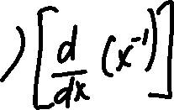

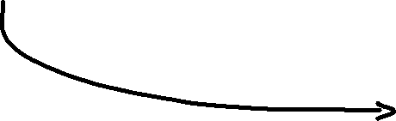










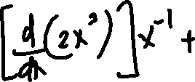
Solution
Practice using the Product Rule. Can simplify and verify using Sum Rule:
Example
^{d} (2x³)(x⁻¹)
dx

Slide 25






The Chain Rule
Our final rule allows us to take derivatives of more complex functions
For example, suppose we want to find ^{df} = ^{d} (2x − 1)⁴, what would we
dx dx
do?
Note that we can express f (x) as a set of nested functions. Call
g(x) = 2x − 1, then f (x) = g(x)⁴ (i.e. g(x) is nested within f (x)). Start here and find the derivative with respect to g:
₄ Use power rule
df
3
f (x) = g(x) −−−−−−−−→ _{dg} = 4g(x)
Now, since g(x) = 2x − 1 is also a function, we should also take the derivative of g(x) with respect to x:
^{dg} = ^{d} 2x − 1 = 2
dx dx

Slide 26
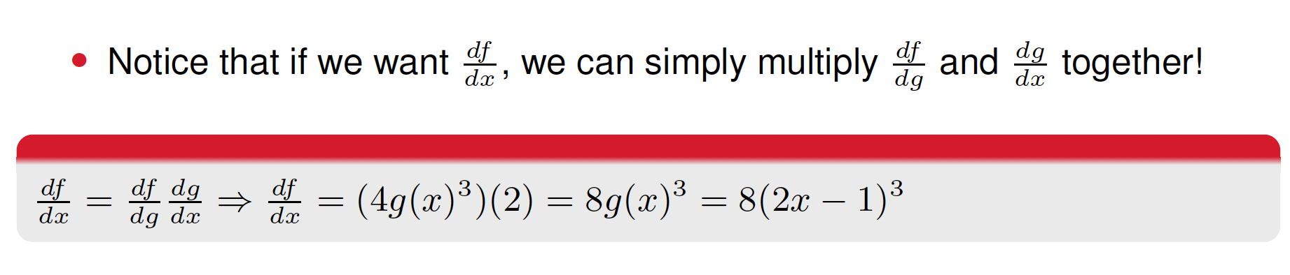
The Chain Rule

Slide 27
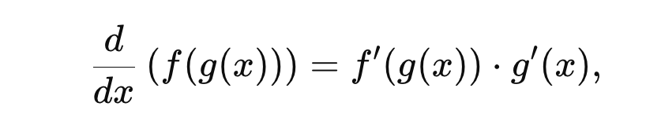
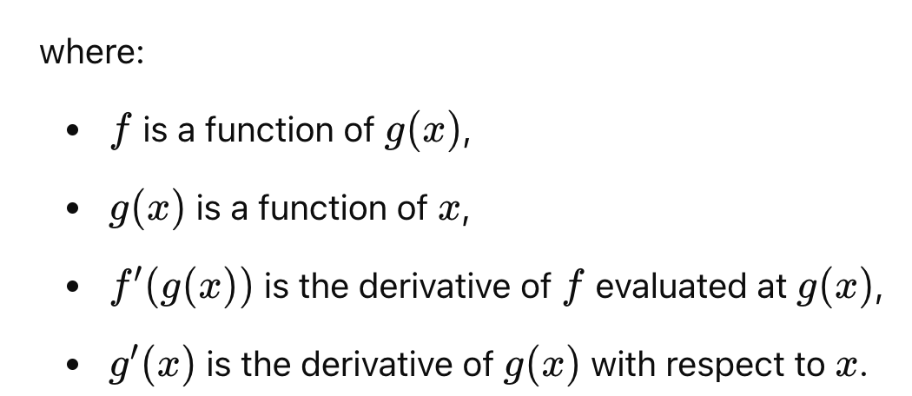
The General expression for the Chain Rule

Slide 28
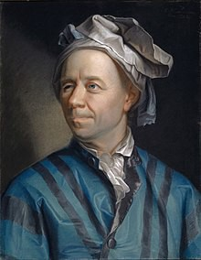





Exponential Functions
Euler’s number, e is a special value equating to approximately 2.71828 (e is also called the exponential number)
We could often see exponential functions such as f (x) = e^{x}
The derivative of the basic exponential function is super easy:
d _{e}x _{= e}x
dx
Leonhard Euler

Slide 29


















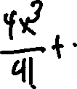





Solution

Slide 30







Logarithmic Functions
Logarithmic functions look like log₂(x) = y (for example). In general, for a logarithmic function log_{a}(x), a is called the base of the function. This can be almost any number, but there are a few common ones, mostly 2, 10, and e
When the base is e, it is called the natural log. You may have seen the notation ln(x) = log_{e}(x). In most upper level maths, the natural log is the default log.
This means when you see log(x) = log_{e}(x). Otherwise, you will see things like log₂(x) or log₁₀(x)
Logarithmic functions have the relationship:
log (x) = y ⇒ a^{y} = x
a
The derivative for a natural log function is:
^{d} log(x) = ¹
dx x

Slide 31
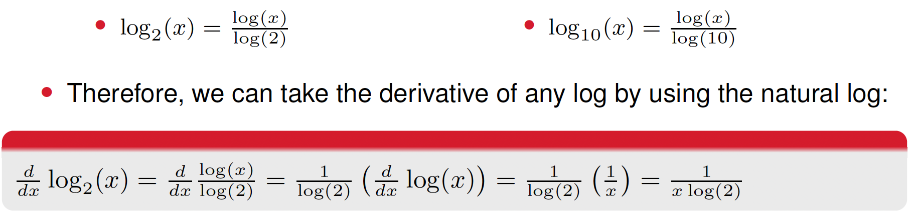






Logarithmic Functions
Since the natural log has such a convenient form for its derivative, it is helpful to know that we can always express other logs in terms of the natural log. For example:

Slide 32

Practice

Slide 33


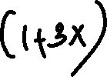
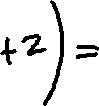


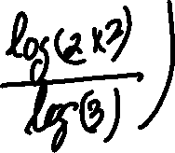


























Solution

Slide 34
Today
Introduction
First Topics
Basic Derivative Rules
4 Derivatives in Python
5 Very Basic Integrals

Slide 35
Using Python to compute the derivatives
In real life, if you need to take the derivative of a function there isn’t a magical solution book where you can verify your result
How do you know that your derivative is correct?
One Solution: you can use Python to verify it
Let’s explore how to do so using the autograd example.ipynb jupyter notebook on Canvas.
Note, after we define the function and our derivative, we use the function
grad() and then
Generate some random numbers, plug them into both, and ensure that our derivative gives the same answer as the auto-generated derivative
Also Note: we will be using Python almost every class to implement the ML
(and math) we learn!

Slide 36
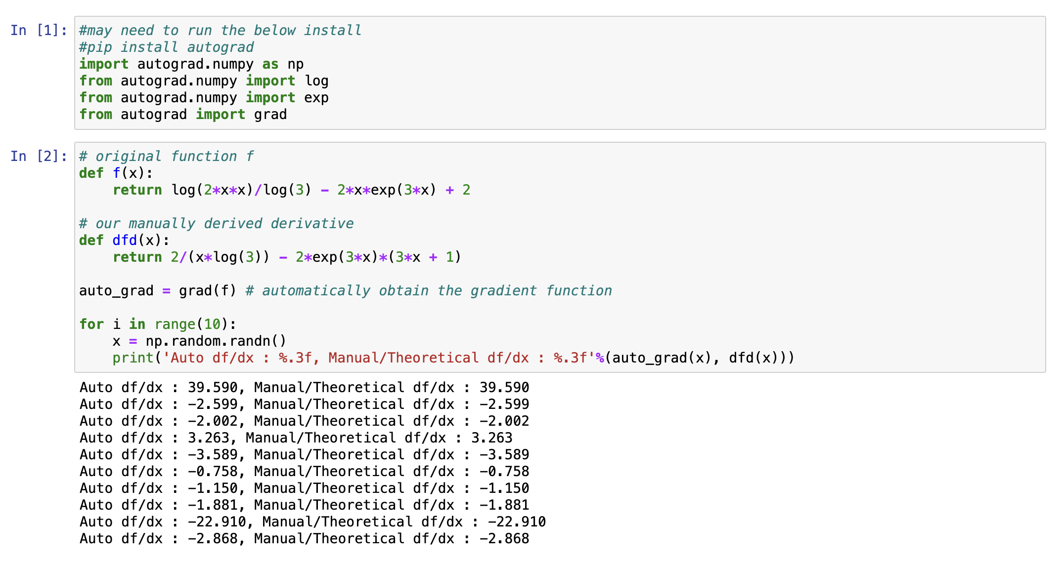



Slide 37
Today
Introduction
First Topics
Basic Derivative Rules
Derivatives in Python
5 Very Basic Integrals

Slide 38
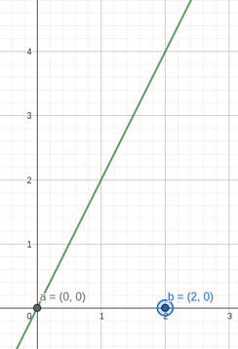


Anti-derivative and Integration
Derivatives tell us if a function is going up or down as x increases. Integrals tell us:
the area under the function from point a to point b
Given the function f (x) = 2x (on right), what is the area of the trian- gle defined by x-values a = 0 and b = 2? We would write:
b
2
2x dx = 2x dx
a
0

Slide 39

Integration
The process of finding the area
b
and solving f (x) dx is
a
called integration, and finding the area gives us the result called the integral of f (x).
Since the simple example on the right is a triangle we can eyeball it: (4 × 2)/2 = 4
How could derive a formulaic way to calculate this?

Slide 40
Why are integrals important in ML?
Probabilities and Distributions
Many ML models rely on probability distributions functions, PDFs. With integrals we can:
Compute probabilities from PDFs.
Normalize distributions: ensuring that the total probability sums to 1:
Calculate cumulative distribution functions (CDFs) and marginal probabilities.
Expectation and Variance
Integrals are used to compute the expected value and variance of random variables
Loss Function Minimization
Integrals help define and evaluate loss functions in certain models.

Slide 41
The relation between integrals and derivatives?
Derivatives Measure Change: A derivative measures the rate of change or the slope of a function at a given point.
Integrals Measure Accumulation: An integral calculates the total accumulation of a quantity, i.e. the area under a curve.

Slide 42
Integration
Suppose that we want to integrate f (x) = 2x from 0 to 2, we write then:
2
2x dx
0
If f (x) = 2x, we can picture the integral (antiderivative) as the function F (x)
where if we took the derivative of F (x), it would give us f (x):
^{d} F (x) = f (x)
dx
We would need to take the derivative “backward”, in this case. Notice that if
F (x) = x², then:
^{d} x² = 2x = f (x)
dx

Slide 43









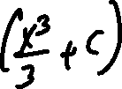
























Antiderivative examples

Slide 44



















Integration
Therefore, the integral of 2x is x². Once we have the integral, the area between the two points is simply the difference between F (x) at the two points:
area = F (2) − F (0) = 2² − 0² = 4
The reason the same constant C is used in both cases when evaluating a definite integral is that the constant of integration represents an arbitrary shift that applies uniformly across the entire antiderivative.

Slide 45
With Python
Check out the scipy grad.ipynb file on Canvas.
Note that it is not always so simple to figure out what the integral is. Just like derivatives, there are several rules you can follow to help you find integrals. We will talk about the most basic rules on the next slide.

Slide 46
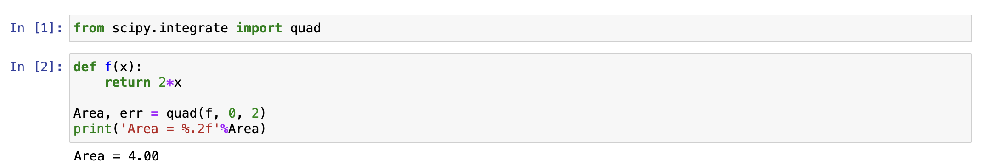
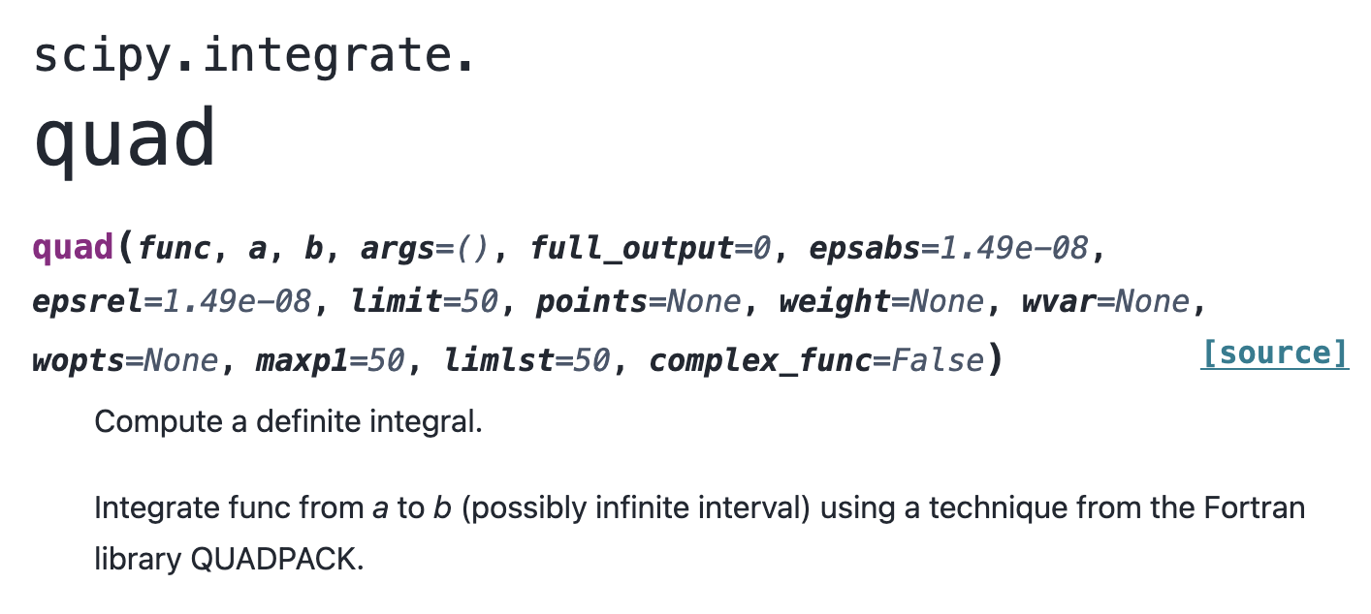





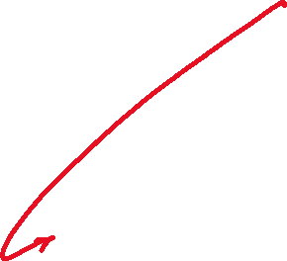




Slide 47
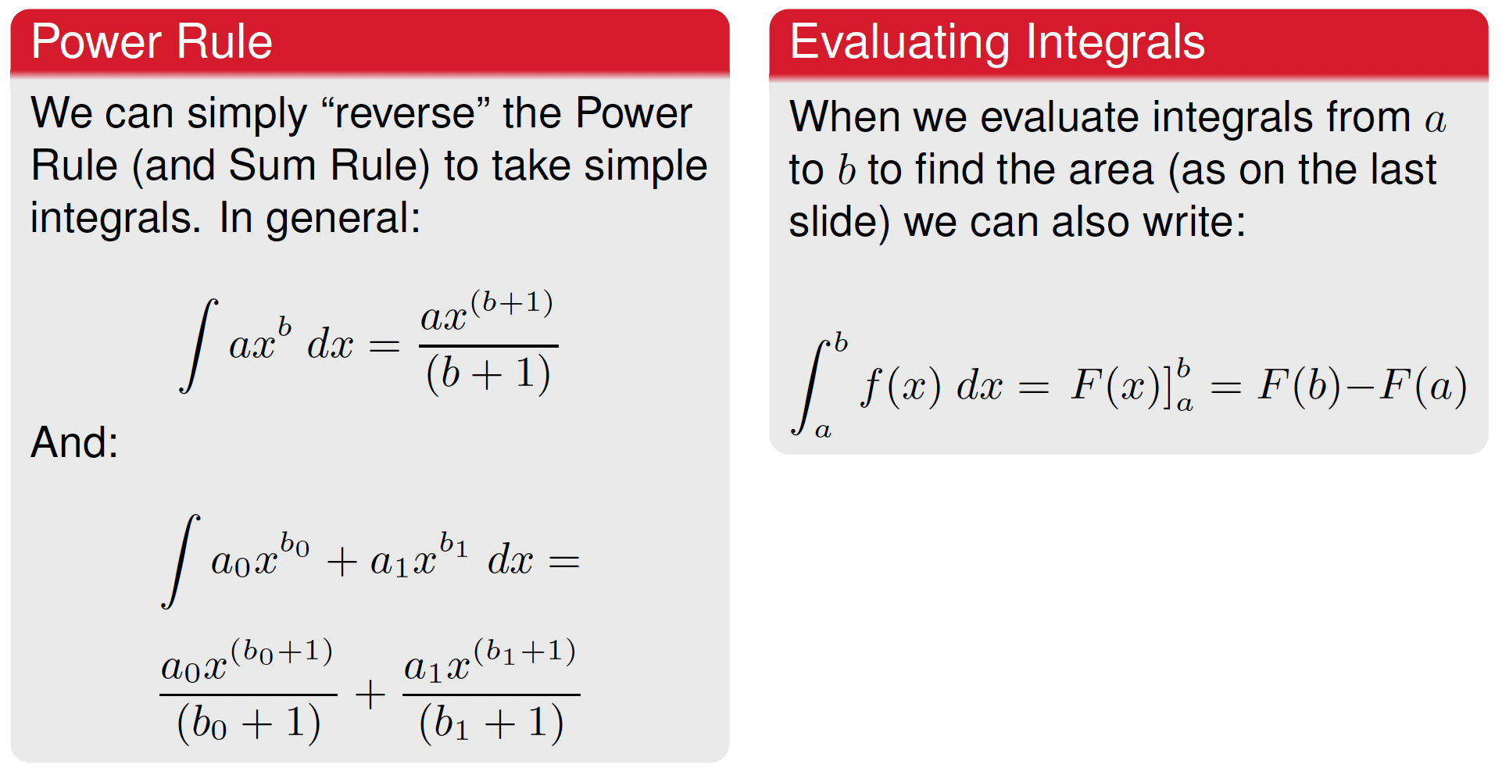
Integration

Slide 48
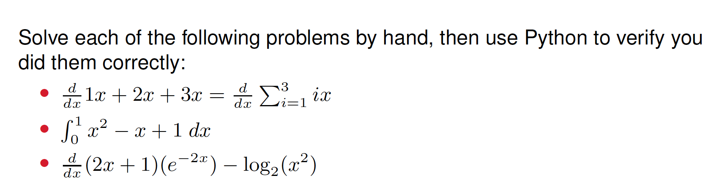
Practice, If Time

Slide 49



















Solution

Slide 50








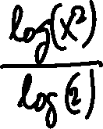



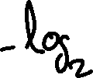





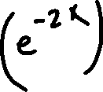

Solution

Slide 51


Slide 52


